Slide 1
cs329e Programming Languages Final Project
Option A
Xiaolin Lu & Kartik Chitturi

Slide 2
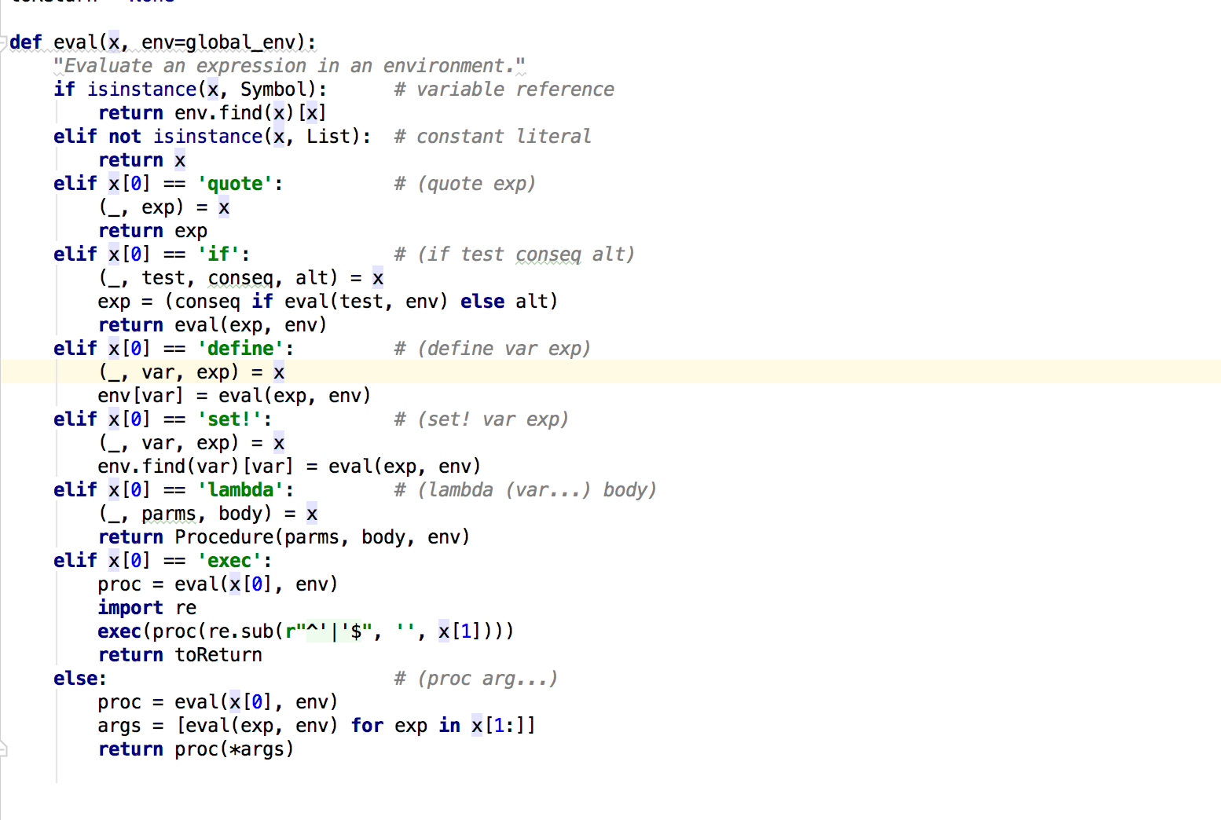
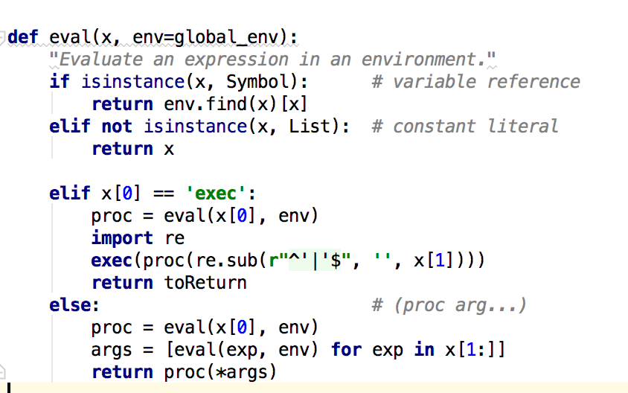
1. Remove excess code (lis.py)

Slide 3
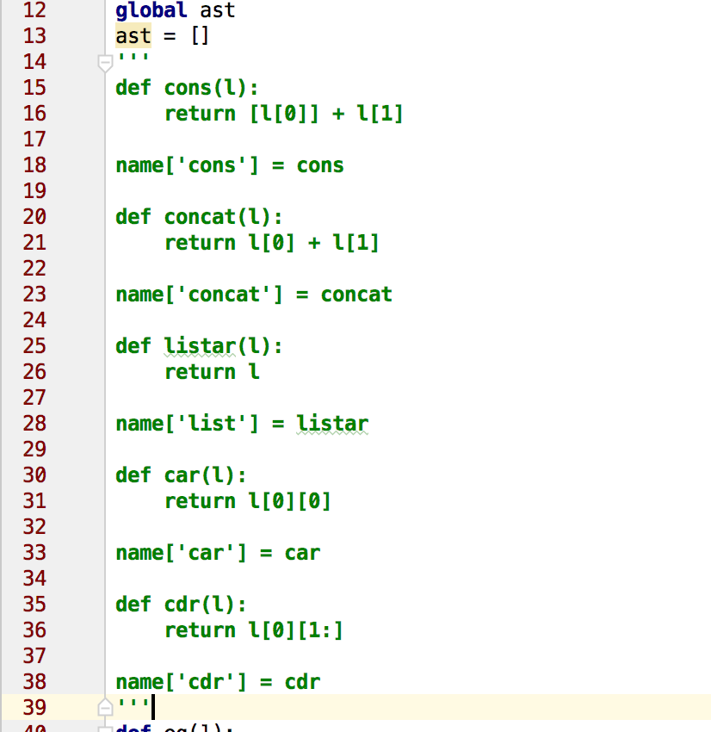
1. Remove excess code (yacc.py)

Slide 4
2. Use of ‘exec’ function

Slide 5
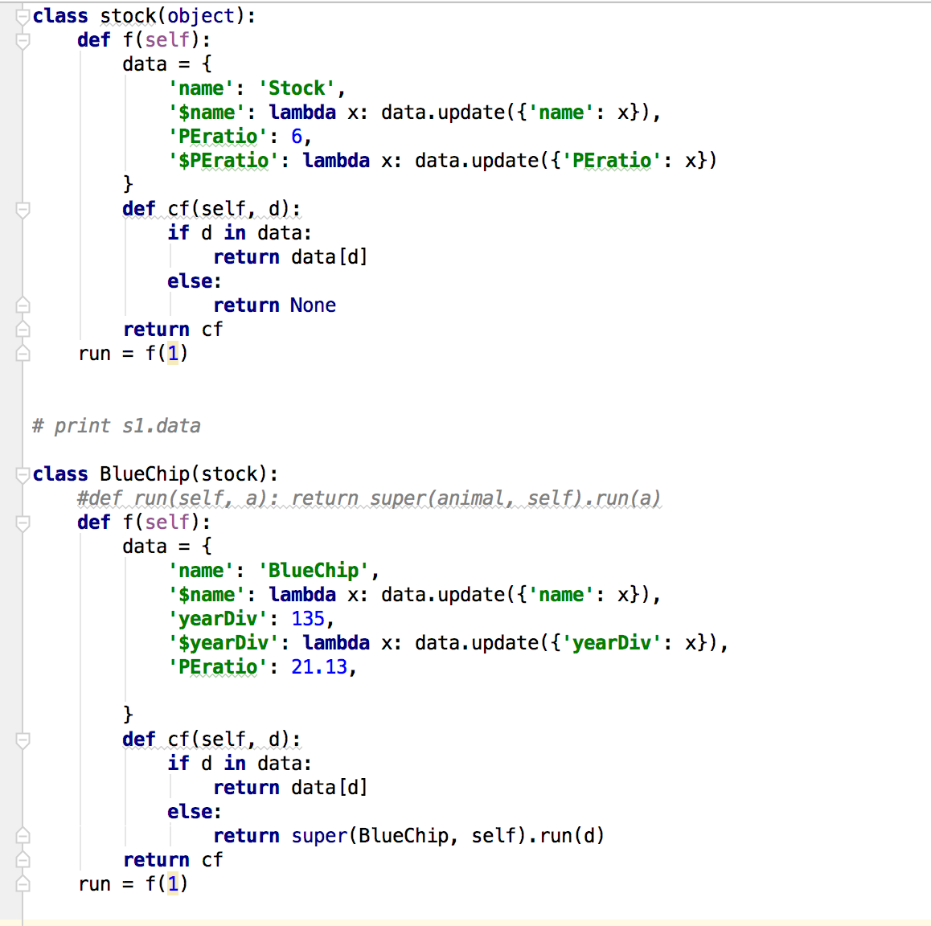
3. Python closures
Closure: a function can reference variables that are defined in the function's enclosing scope

Slide 6
3. Python closures
ml> (exec 'from Stocks import stock; s1 = stock(); toReturn = s1.run('PEratio') ') ml> (exec 'from Stocks import stock; s1 = stock(); s1.run('$PEratio')(8); s1.run('PEratio') ')
ml> (exec 'from Stocks import stock, BlueChip; b1 = BlueChip(); toReturn = b1.run('yearDiv') ')

Slide 7
4. Java streams operation
ml> (exec 'import Stock, Sector, ListComprehension; s1 = ListComprehension(); s1.allSector()')
ml> (exec 'import Stock, Sector, ListComprehension; s1 = ListComprehension(); s1.orderStocks()')
ml> (exec 'import Stock, Sector, ListComprehension; s1 = ListComprehension(); s1.selectStocks()')
ml> (exec 'import Stock, Sector, ListComprehension; s1 = ListComprehension(); s1.filterStocks(10.0, 100.0)')
ml> (exec 'import Stock, Sector, ListComprehension; s1 = ListComprehension(); s1.avgDEratio()')

Slide 8
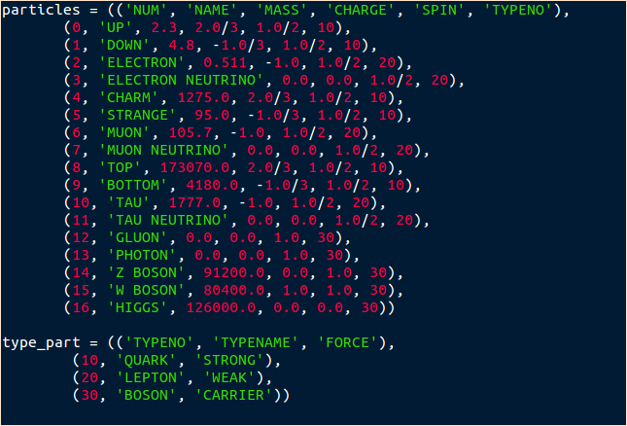
5. Python Lambda & List comprehension

Slide 9
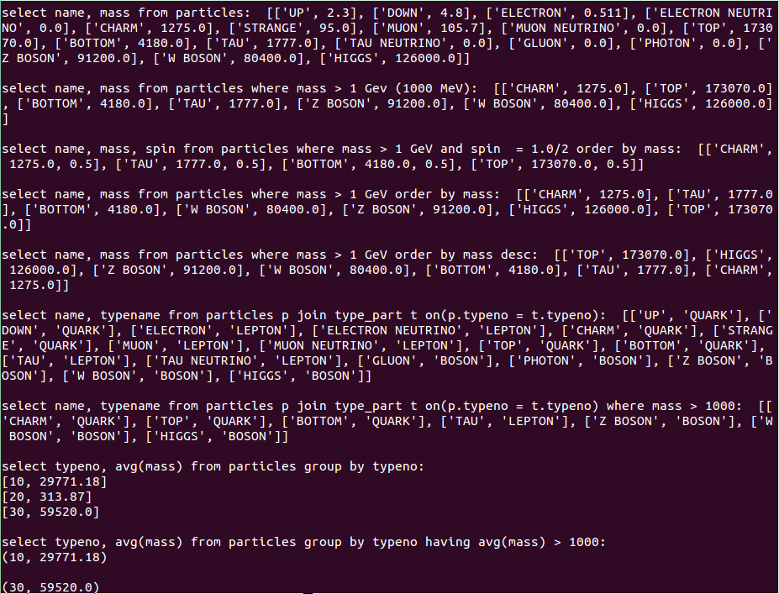

Slide 10
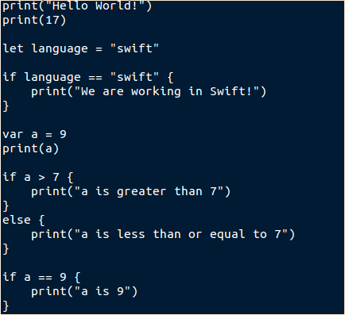
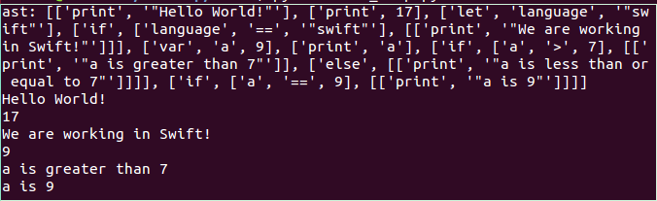
Swift

Slide 11


